Slide 2
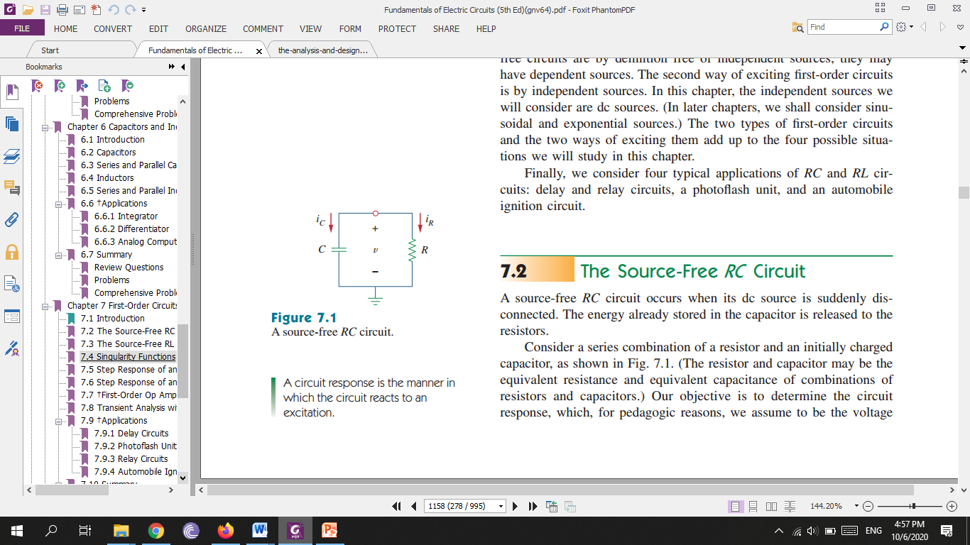

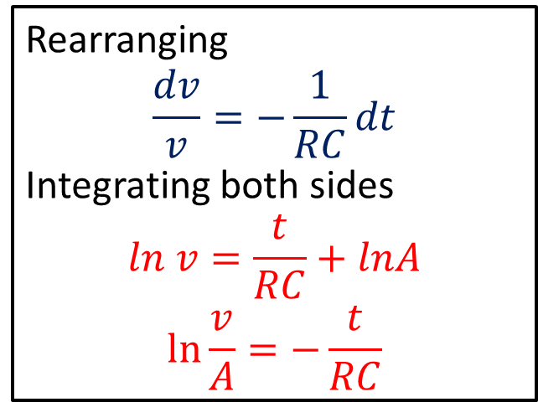
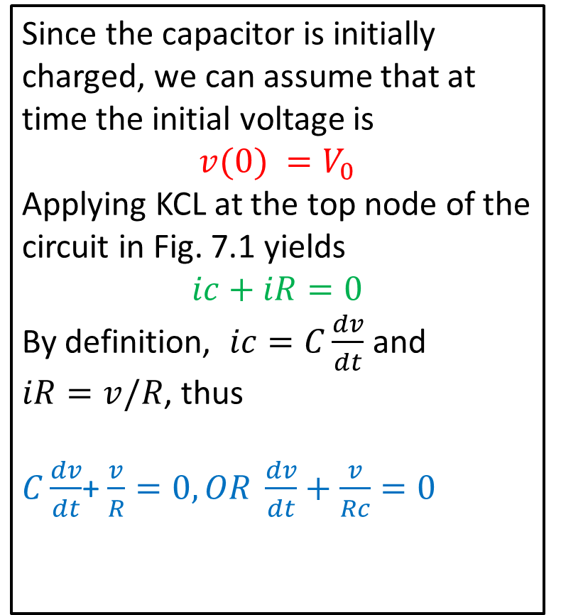
The Source-Free RC Circuit
Since the capacitor is initially charged, we can assume that at time the initial voltage is
$$v(0) =V_{0}$$ Applying KCL at the top node of the circuit in Fig. 7.1 yields $$ic+iR=0$$
By definition, $ic=C\frac{dv}{dt}$ and $iR=v/R$, thus
$C\frac{dv}{dt}$+ $\frac{v}{R}=0, OR \frac{dv}{dt}+\frac{v}{Rc}=0$
Rearranging
$$\frac{dv}{v}=−\frac{1}{RC}dt$$
Integrating both sides
$$ln v=\frac{t}{RC}+lnA$$
$$\ln{\frac{v}{A}=−\frac{t}{RC}}$$

Slide 3
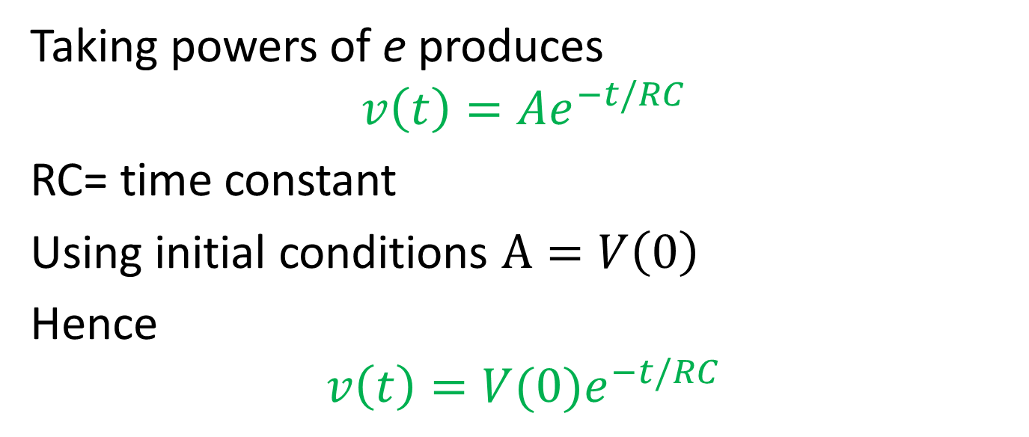
Taking powers of e produces
$$v\left(t\right)=Ae^{−t/RC}$$ RC= time constant
Using initial conditions $A=V\left(0\right)$
Hence
$$v\left(t\right)=V(0)e^{−t/RC}$$
The natural response of a circuit refers to the behavior (in terms of voltages and currents) of the circuit itself, with no external sources of excitation.

Slide 4
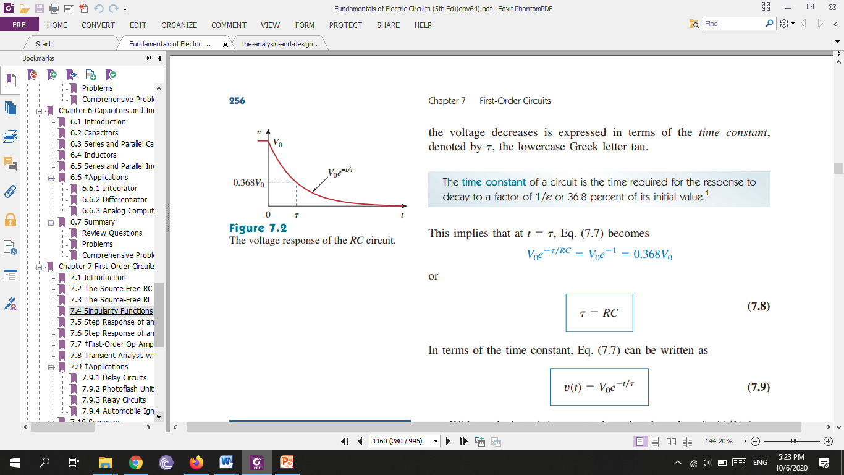
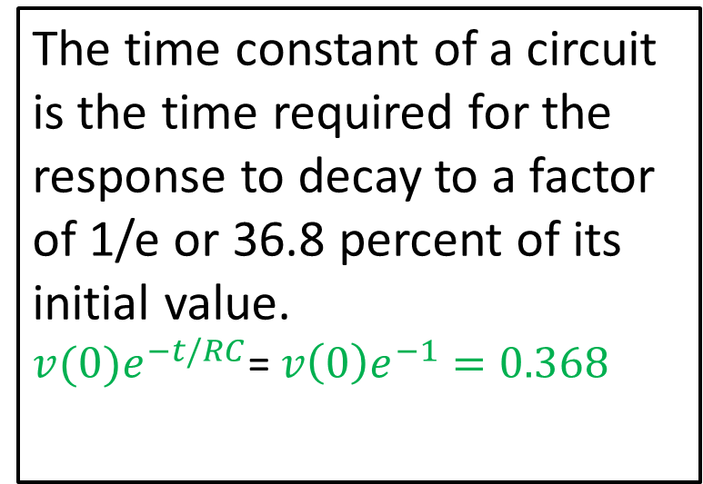
The time constant of a circuit is the time required for the response to decay to a factor of 1/e or 36.8 percent of its initial value. $v(0)e^{−t/RC}$= $v\left(0\right)e^{−1}=0.368$

Slide 5
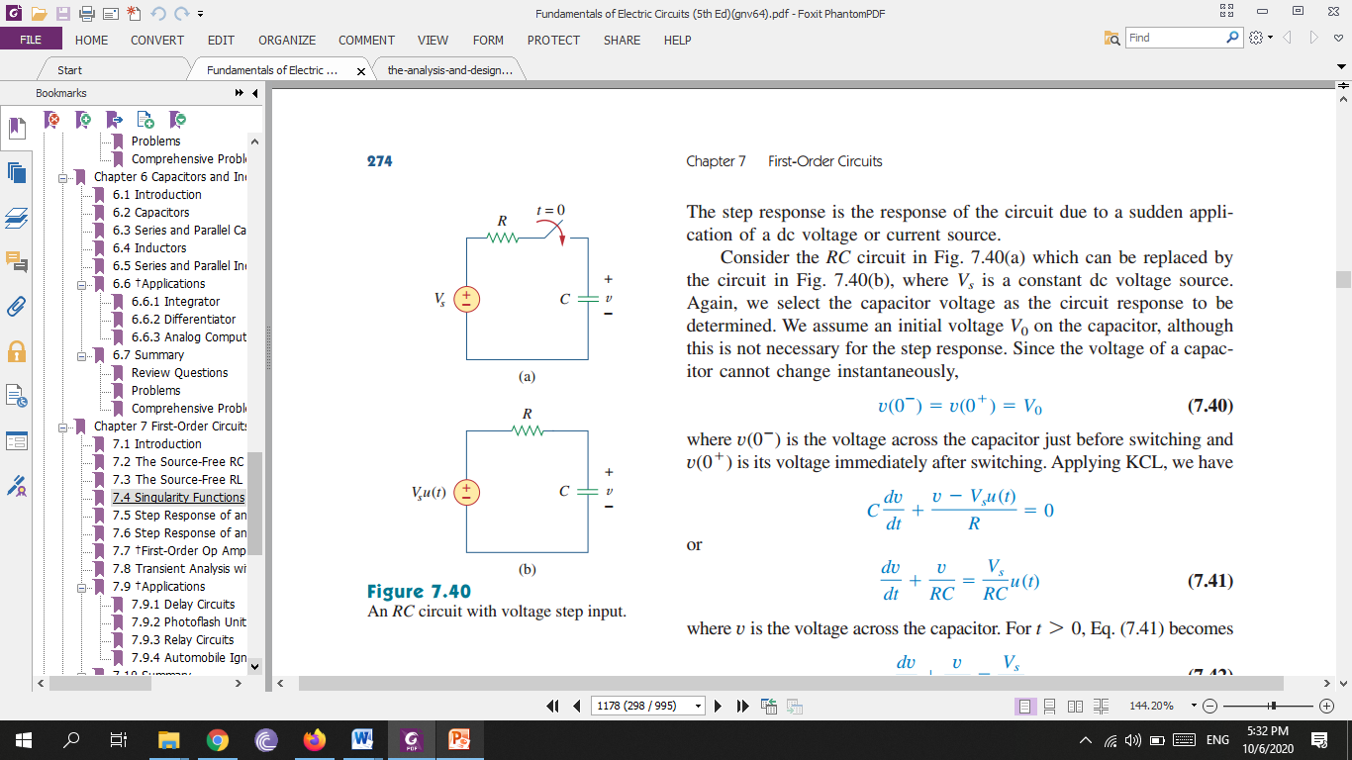
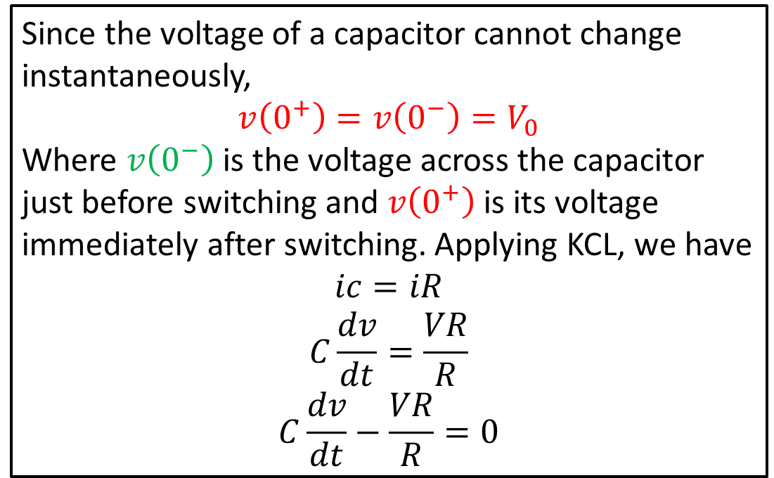
Step Response of an RC Circuit
The step response of a circuit is its behavior when the excitation is the step function, which may be a voltage or a current source.
Since the voltage of a capacitor cannot change instantaneously, $$v\left(0^{+}\right)=v\left(0^{−}\right)=V_{0}$$
Where $v\left(0^{−}\right)$ is the voltage across the capacitor just before switching and $v\left(0^{+}\right)$is its voltage immediately after switching. Applying KCL, we have $$ic=iR$$
$$C\frac{dv}{dt}=\frac{VR}{R}$$
$$C\frac{dv}{dt}−\frac{VR}{R}=0$$

Slide 6
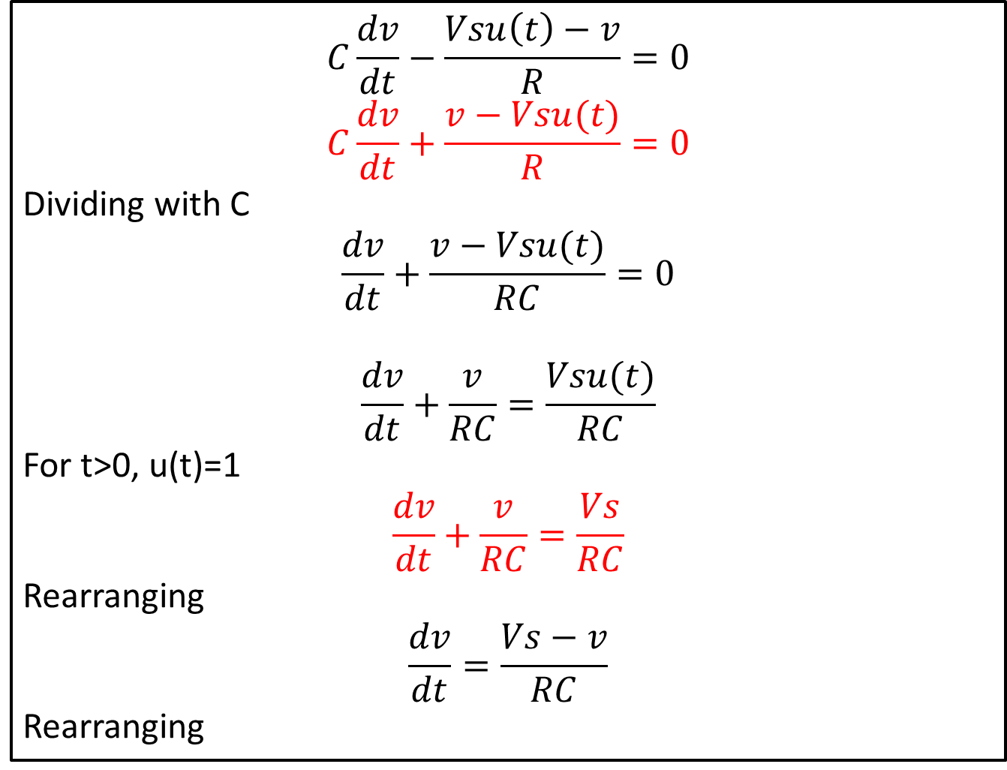
$$C\frac{dv}{dt}−\frac{Vsu\left(t\right)−v}{R}=0$$
$$C\frac{dv}{dt}+\frac{v−Vsu(t)}{R}=0$$
Dividing with C
$$\frac{dv}{dt}+\frac{v−Vsu(t)}{RC}=0$$
$$\frac{dv}{dt}+\frac{v}{RC}=\frac{Vsu(t)}{RC}$$
For t>0, u(t)=1
$$\frac{dv}{dt}+\frac{v}{RC}=\frac{Vs}{RC}$$
Rearranging
$$\frac{dv}{dt}=\frac{Vs−v}{RC}$$
Rearranging

Slide 7
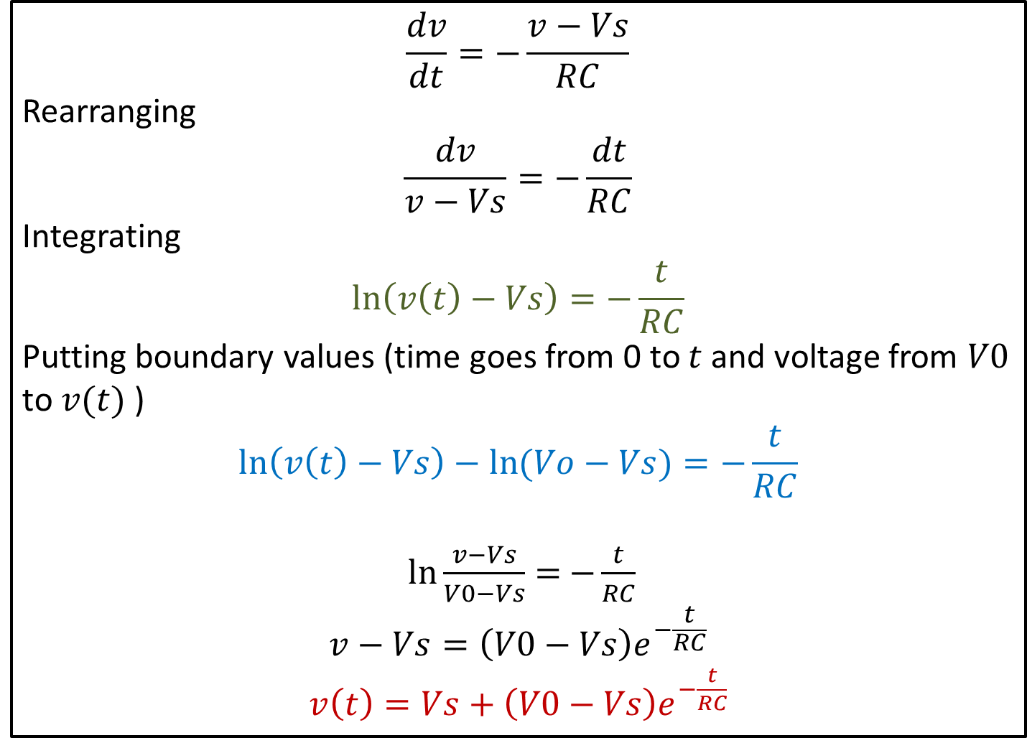
$$\frac{dv}{dt}=−\frac{v−Vs}{RC}$$
Rearranging
$$\frac{dv}{v−Vs}=−\frac{dt}{RC}$$
Integrating
$$\ln\left(v\left(t\right)−Vs\right)=−\frac{t}{RC}$$
Putting boundary values (time goes from 0 to $t$and voltage from $V0$ to $v(t)$ )
$$\ln\left(v\left(t\right)−Vs\right)−\ln{(Vo−Vs)}=−\frac{t}{RC}$$
$\ln{\frac{v−Vs}{V0−Vs}=}$ $−\frac{t}{RC}$
$$v−Vs=\left(V0−Vs\right)e^{−\frac{t}{RC}}$$
$v\left(t\right)=Vs+$ $\left(V0−Vs\right)e^{−\frac{t}{RC}}$

Slide 8
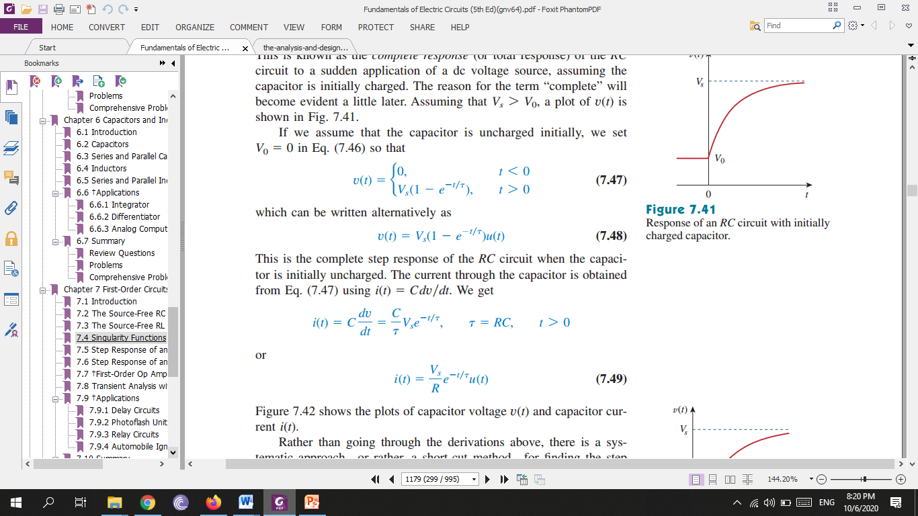
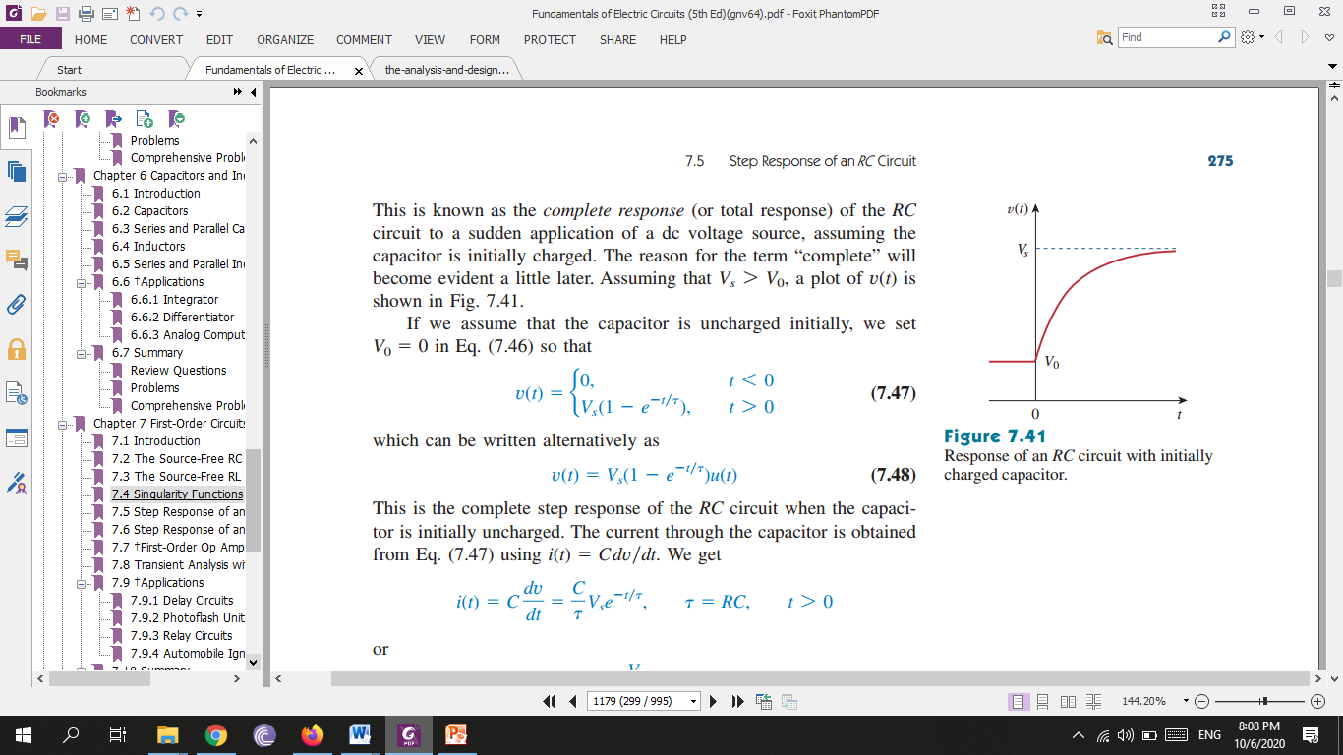

Slide 9
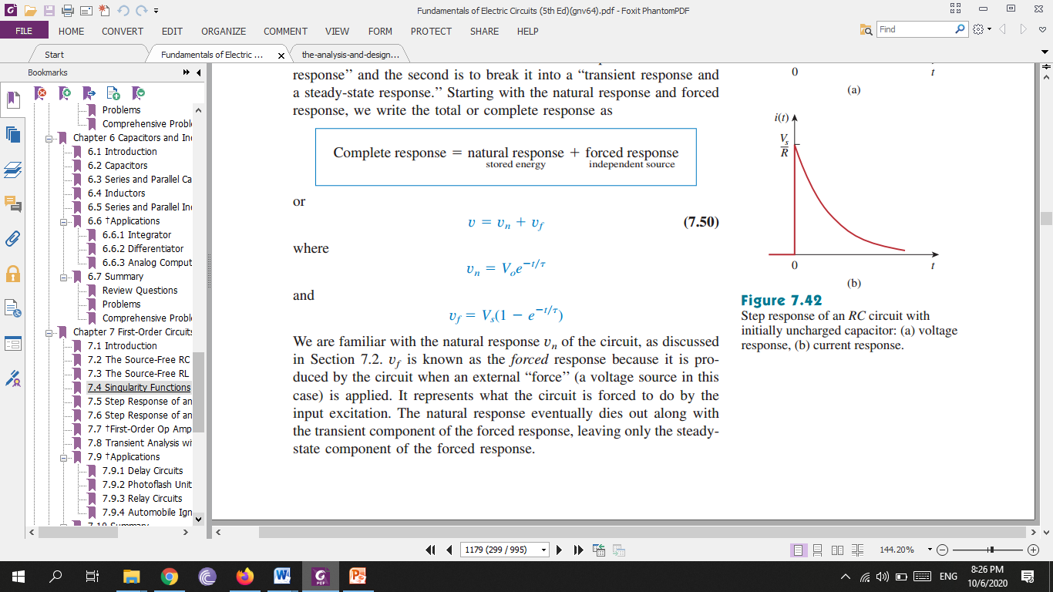
Complete response = natural response (stored energy) + forced response (independent source)

Slide 10
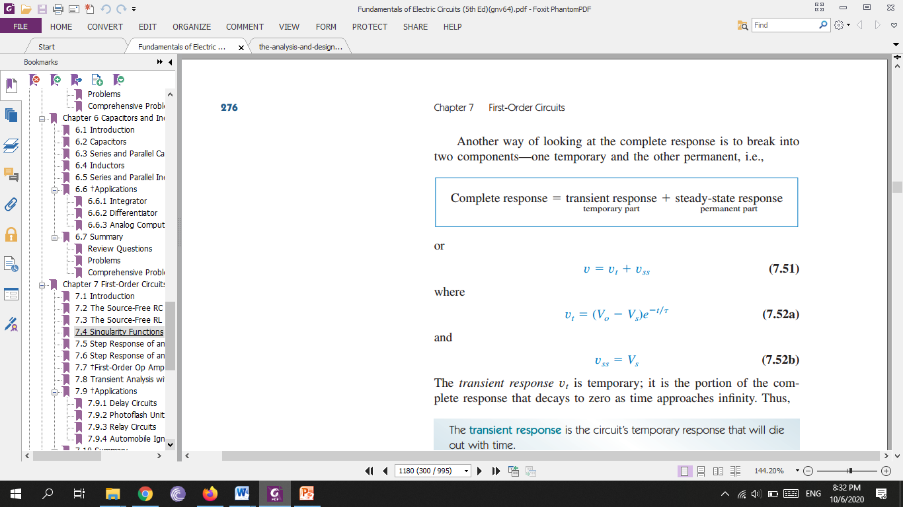
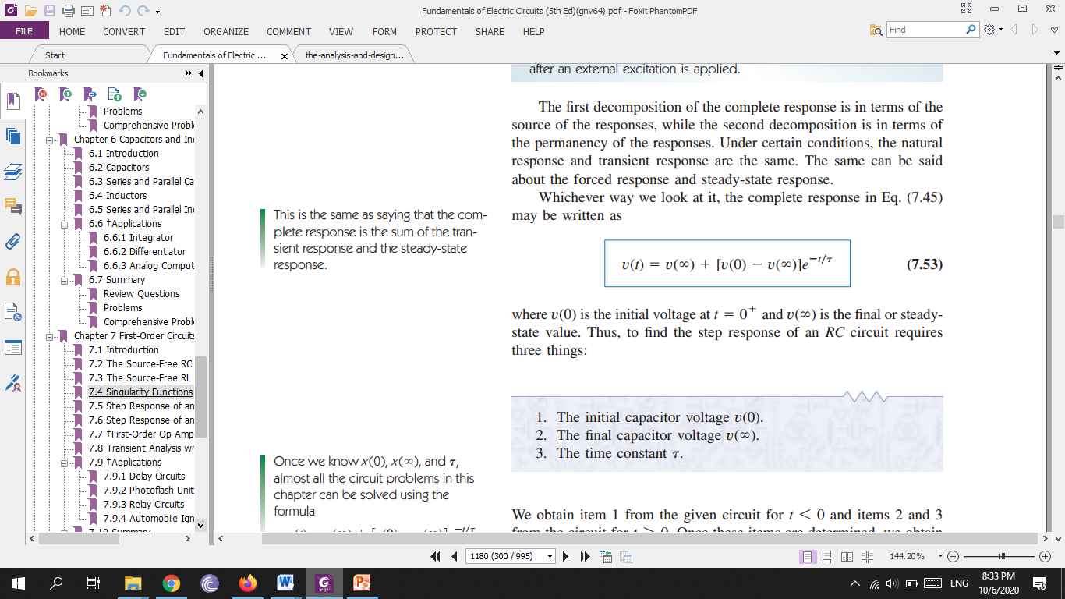
Complete response = transient response (temporary part)+ steady-state response (permanent part)
The transient response is the circuit’s temporary response that will die out with time
The steady-state response is the behavior of the circuit a long time after an external excitation is applied.

Slide 11
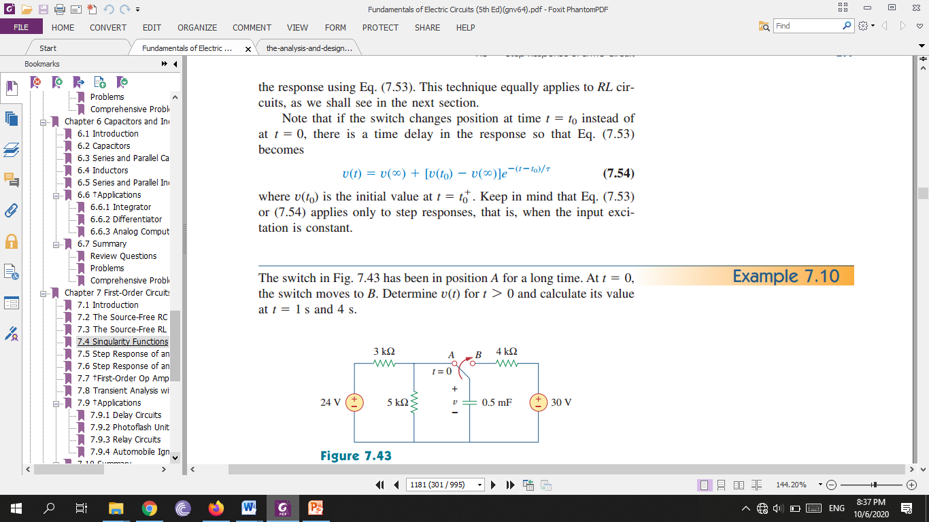
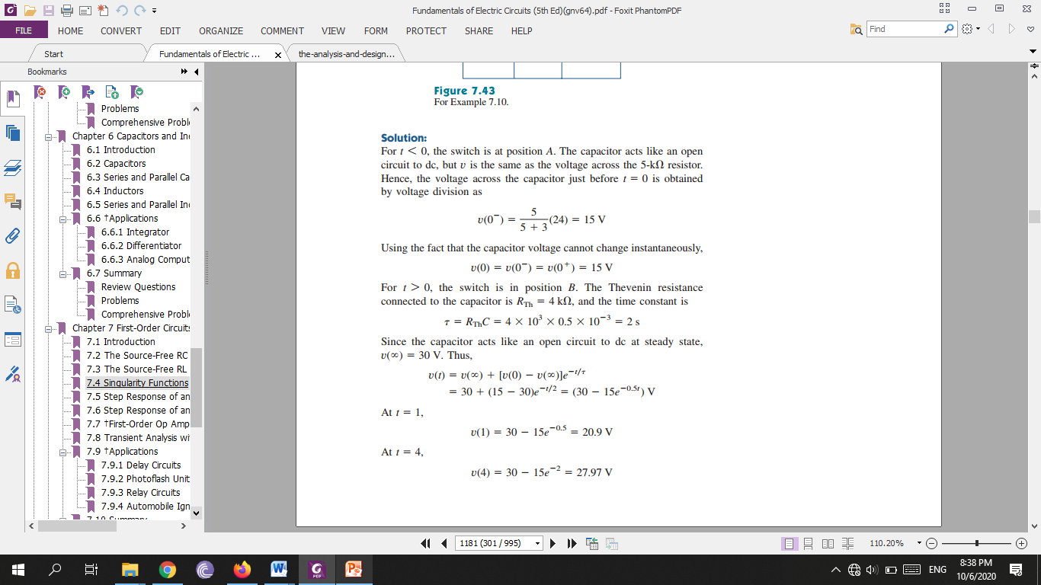

Slide 12
